Slide 1
11. Enterprise Knowledge Graphs
John P. McCrae
CT5166

Slide 2
Course structure
9th Sep | Introduction to Knowledge Graphs | 21st Oct | Inductive reasoning
16th Sep | Models for Knowledge Graphs | 28th Oct | KG Creation (no lab on Monday)
23rd Sep | Querying and Serialization | 4th Nov | KG Alignment
30th Sep | Schemas | 11th Nov | Publishing and Linked Open Data
7th Oct | Deductive reasoning | 18th Nov | Linguistic Linked Open Data
14th Oct | No Lecture | 25th Nov | Enterprise Knowledge Graphs

Slide 3
Architecture of Enterprise Knowledge Graphs

Slide 4
Abstract Reference Architecture
Knowledge Acquisition
Knowledge Consumption
Understanding
Quality Assurance
Entity Summary
Ontology Development
Graph Summary
Exploitation
Data Linking
Semantic Search
Data Lifting
Query Generation
Question Answering
Knowledge Storage
Source: Pan et al., “Exploiting Linked Data and Knowledge Graphs in Large Organisations”

Slide 5
Knowledge Acquisition
Where do we get knowledge from?
Data Lifting: Extraction from legacy sources
Data Linking: Incorporating data from external (open) sources
Ontology Development: Structuring and organising data
Quality Assurance: Validation and improvement of data.
This is a cyclical process; quality assurance makes us get more data or structure the data we have better.

Slide 6
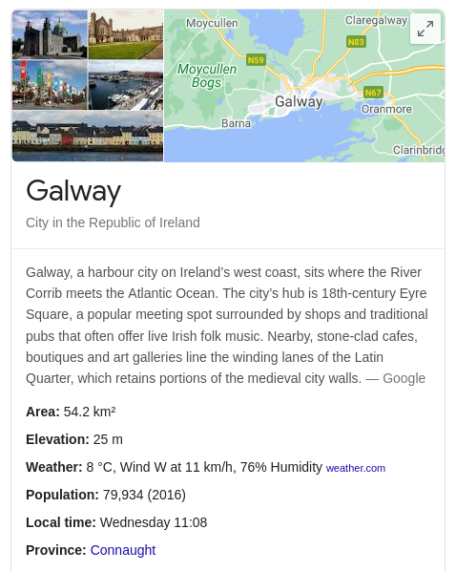
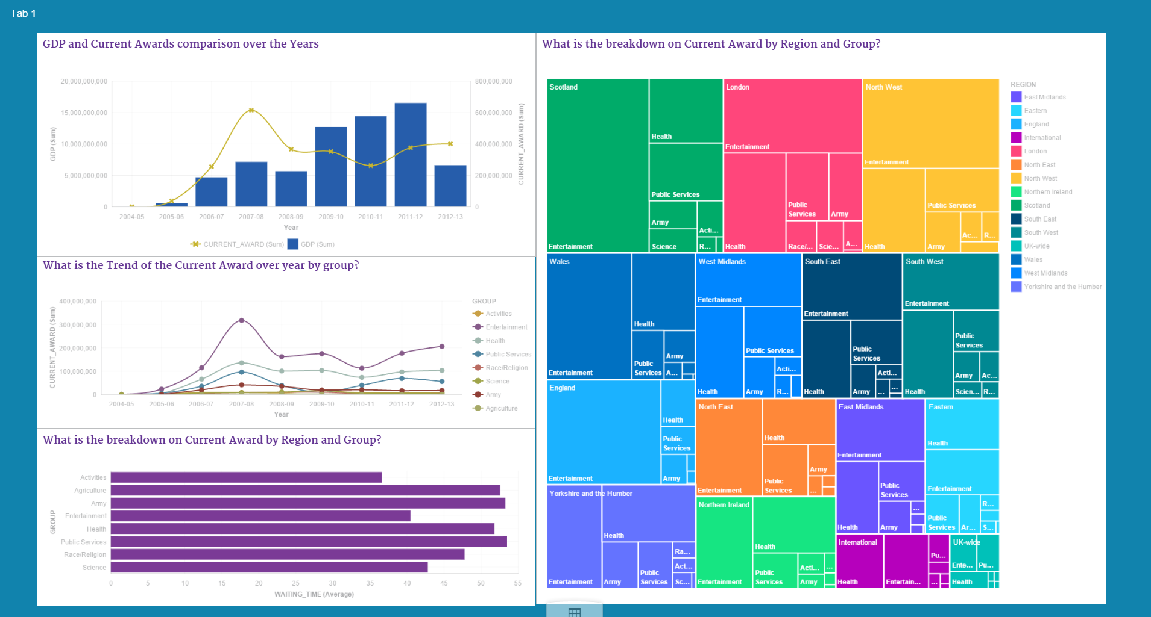
Understanding
What can we learn from the knowledge?
Understanding
Summarize the knowledge into actionable reports
Entity summarization focuses on a single element of the graph
Graph summarization focuses on the whole graph
Entity Summary
Graph Summary

Slide 7
Exploitation
How can we use the knowledge?
Semantic Search: Improve search by using knowledge graph entities
Query Generation: Quickly write (SPARQL) queries using knowledge graph
Question Answering: Answer full questions in natural language.

Slide 8
Knowledge Storage

Slide 9


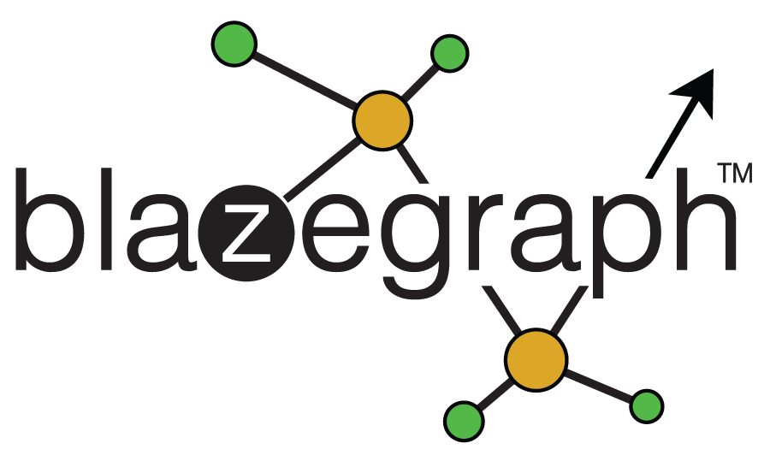



RDF Databases

Slide 10
Advantages of Graph Databases
Flexible schemas adapt to heterogeneous data
NoSQL (Not Only SQL) allows for fast deployment
Standards compliant:
OWL Reasoning
SPARQL
Linked Data Fragments

Slide 11
Graph databases vs. Relational databases
Relational database need schemas
(+) Fast indexes that can be optimized for the application
(-) Schema needs to be changed as data changes
(-) Schemas take time to write
(-) Joins across tables are slow; graph databases optimized for joins
(+) Data locality, most relevant data is in the same table and needs no joins

Slide 12
Hybrid Solutions
SQL DB
Semantic Object Relational Mapping
Transform
RDF
Document DB
Schema Transformer
JSON-LD
RDF

Slide 13
Relational or Graph?
A list of customers and their details (address, payment methods, etc.)
Modelling employees’ areas of expertise, projects and tasks
Products maintained by the company and facts about them

Slide 14
Knowledge Acquisition

Slide 15
Data Lifting
Step 1
Identify and analyse data sources
Step 2
Design a URI scheme
Step 3
Model the ontology of the data
Many large enterprises have lots of data in SQL DBs, Excel, Server Logs, etc. etc.
Step 4
Transform the data to RDF
Step 5
Add links to external resources
Step 6
Publish the data

Slide 16
URI Schemas
Rules for choosing a ‘cool’ URI
Be on the Web: ensure you can put something at the URI location!
Be unambiguous: use content negotiation to keep resource and document URIs separate
Be meaningful: dbpedia:Linked_data is better than wikidata:Q515701
Use slashes for main entities: http://example.com/person/alice
Use hashes for entities that ‘evolve together’: http://example.com/person/alice#address
Source: https://www.w3.org/TR/cooluris/#ref-Cool

Slide 17
Ontology Authoring
Example Competency Questions
CQOA is a popular method of ontology authoring based on competency questions
Which mammals eat grass?
(in an animal ontology)
Which processes implement an algorithm?
(in a software engineering ontology)

Slide 18
Competency Question Ontology Authoring
Formulate Questions
Extract
Requirements
Create Tests
Author Ontology

Slide 19
Writing Competency Questions
Question Type: Yes/No, Which?, How many?
Element visibility: Clearly state the relations and classes.
Predicate arity: Does this involve a single triple or multiple?
Relation type: Object or datatype properties?
Modifiers: e.g., more than 3, less than 10%
Domain-independence: Does this depend strongly on the task or on general properties (e.g., temporal/spatial properties)

Slide 20
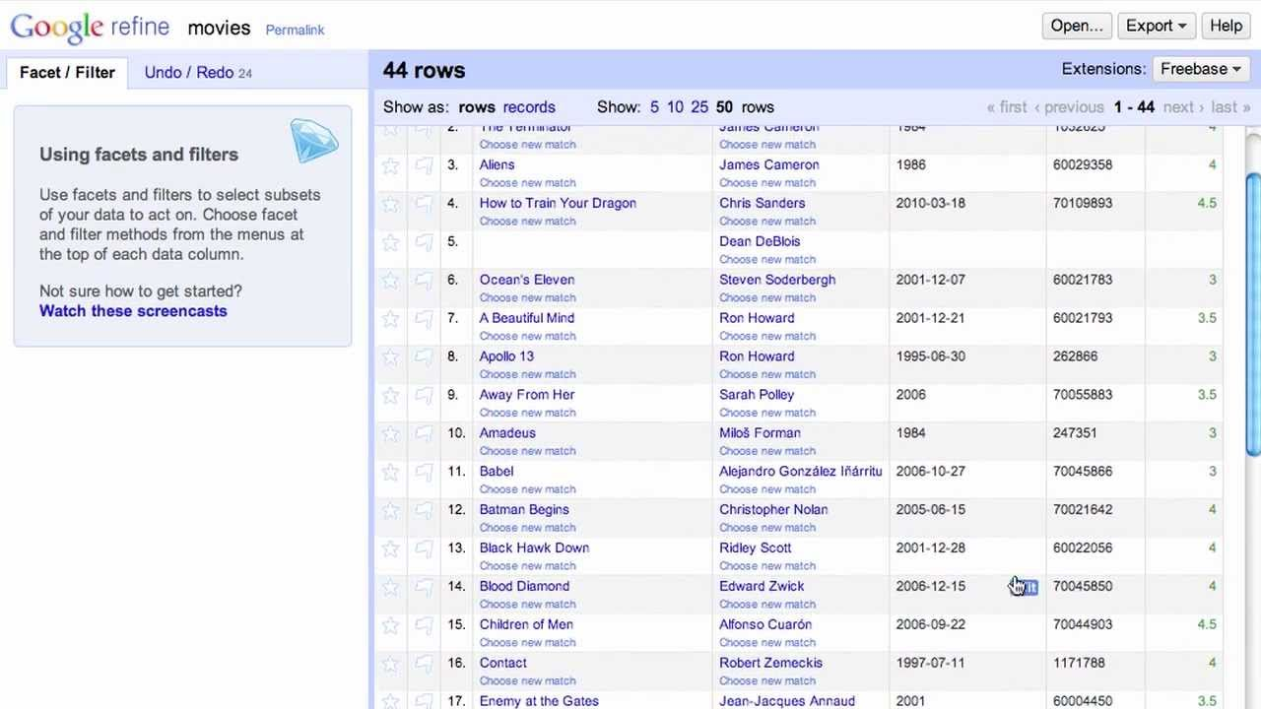
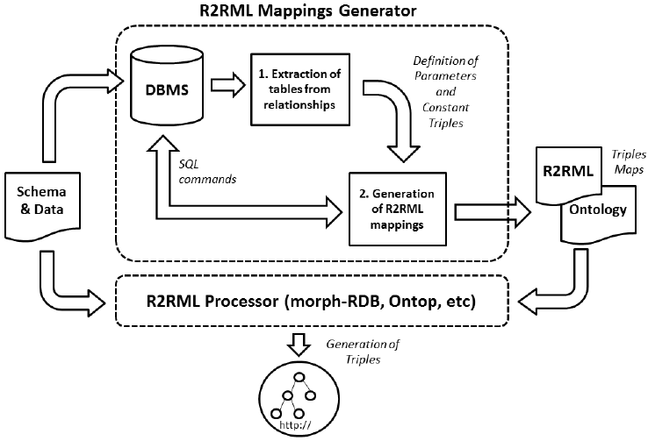
Data Transformation
Tabular data
OpenRefine (formerly Google Refine) has RDF export plugins
CSV on the Web can write transformations
R2RML is a general transformation language for CSV/SQL

Slide 21
Data Transformation
cmd.Header --> (
handle(cmd.MdCreator),
handle(cmd.MdCreationDate),
handle(cmd.MdSelfLink),
handle(cmd.MdProfile),
handle(cmd.MdCollectionDisplayName)
)
cmd.MdCreator --> (
dc.creator > content
)
(cmd.MdCreationDate when
(content !== "")) --> (
dct.issued > (content ^^ xsd.date)
)
XML data
XSLT can convert RDF from XML
Krextor adds some extensions to improve this
LIXR is a simplified model for mapping language

Slide 22
Data Linking
Techniques covered last week
Open Data + Enterprise Data
= Profit

Slide 23
Publishing
Some RDF databases can host data directly.
Design around user needs
Framework for creating better data interfaces:
Pubby, Yuzu

Slide 24
Knowledge Consumption

Slide 25
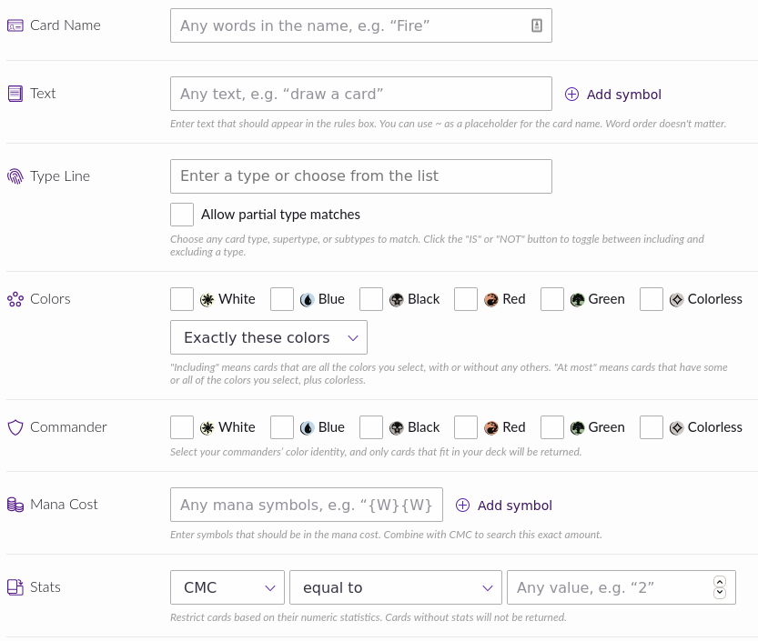
Semantic Search
🔎 User Search Query
User selects entities from KG as part of query process
Semantic Index
Results
Relevant entities are inferred using NLP Techniques

Slide 26
Entity Summarisation
KG may have many facts about an entity, e.g., Wikidata on Galway
https://www.wikidata.org/wiki/Q129610
What is important to show the user?
Criteria for Knowledge Selection:
Centrality of triple
Kind of information (descriptions, numeric, identifiers)
Source of information

Slide 27
Graph Summarization
Statistics that can be extracted about a graph:
Size
Coverage of domain
Labels and documentation
Connectivity
Ambiguity of labels

Slide 28
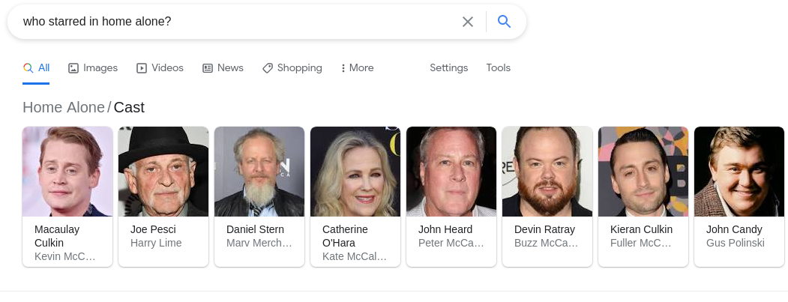
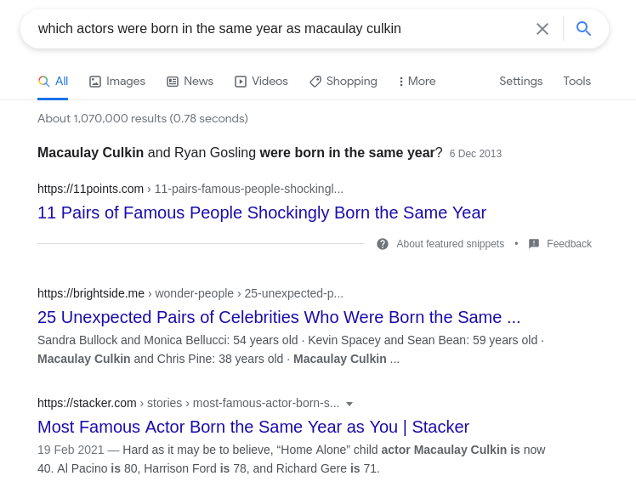
Question Answering as Information Retrieval
Who starred in Home Alone?
Which actors were born in the same year as Macaulay Culkin?

Slide 29
Answer using SPARQL
Who starred in Home Alone?
Use Wikidata/DBpedia?
Which actors were born in the same year as Macaulay Culkin?
Did Macaulay Culkin star in a film with an actor born in the same year?

Slide 30
Question Answering over Knowledge Graphs
Linguistic Analysis
Map the extracted terms to URIs
Entity Mapping
Combine triples into a single SPARQL query
Use NLP tools to analyse the queries and construct linguistic triples <subject, predicate, object>
Triple Identification
Find triples that combine the URIs filtering for domain/range restrictions
Query Formulation
Source: PowerAQUA by Lopez et al., http://oro.open.ac.uk/32164/1/swj102_2.pdf

Slide 31
Question Answering in Enterprise
Enterprise KGs are higher quality and less diverse
Enterprise users want reliable and explicable answers
Enterprise users ask more specific questions
Feedback can be collected directly

Slide 32
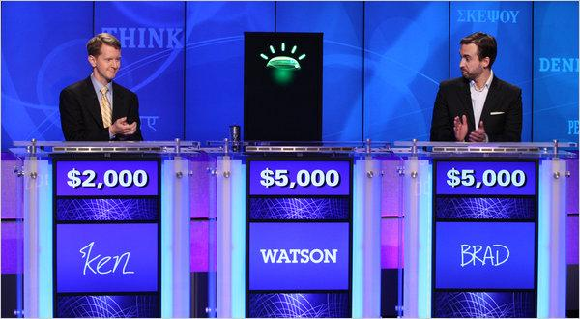
Watson DeepQA
AI that appeared on US game show Jeopardy! in 2011
Based on DeepQA system developed by IBM research
Used many methods including linked data!

Slide 33

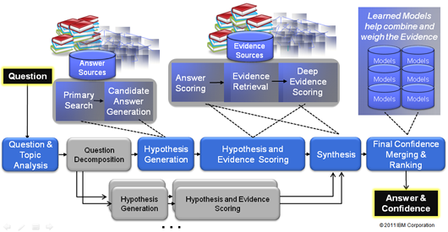

Watson DeepQA Architecture

Slide 34
Case studies

Slide 35






HAVAS-18 Knowledge Graphs
Information about startups in their first 18 months
Linked facts about startups, founders, investors
HAVAS-18 Knowledge Graph

Slide 36
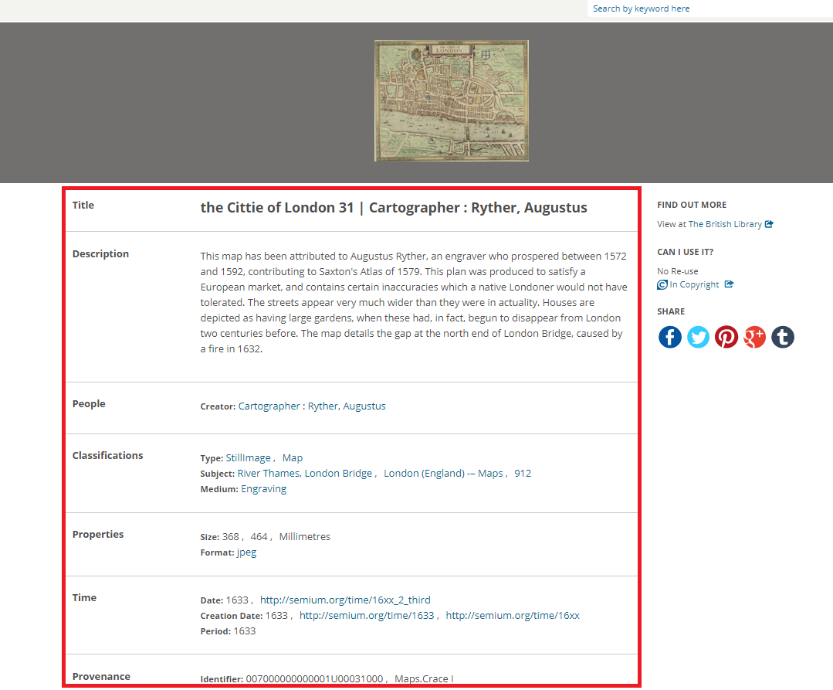

Europeana - Linking Cultural Heritage
Europeana is a single access point to millions of books, paintings, films, museum objects and archival records
Provides access to 2.4 million texts, images, videos and sounds from European museums
Linked Data and SPARQL available at http://data.europeana.eu/

Slide 37
Oncology
NLP and Linked Data were used to analyse Clinical Practice Guidelines
Electronic Health Records (EHRs) are complex, heterogeneous and stratified over time
Doctors reported data and this was compared to guidelines in order to:
Help doctors understand clinical deviations
Help to understand decision-making process
Improve clinical practice guidelines
The National Institute for Tumours (INT) aggregated data over 50 health care providers in Northern Italy

Slide 38
What techniques from the course do you think would be useful for these case studies?

Slide 39
Conclusion

Slide 40
Key points
Knowledge Graph Storage
Many solutions
Relational vs Graph vs Hybrid?
Knowledge Graph Acquisition
How to combine legacy enterprise resources
Linking to open data and publishing
Knowledge Graph Consumption
Summarisation and data analysis
Question answering from knowledge graphs

Slide 41
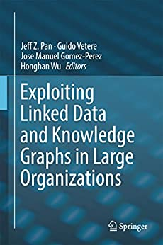
Further Reading
Pan et al., “Exploiting Linked Data and Knowledge Graphs in Large Organizations”
(Available in Hardiman Library)

